Slide 1




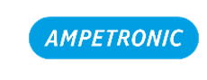
From PIS to Multimedia Services:
Standards and Market Trends
Davide AMATO - Sadel S.p.A. - Castel Maggiore (BO), Italy
Victoria CALLEJA DURO - International Union of Railways - Paris, France
Laurent LLERENA - SNCF Rolling Stock Engineering Center - Le Mans, France
Eric LAVILLONNIERE - Mitsubishi Electric R&D Centre Europe - Rennes, France
Tom LANE - Ampetronic Ltd - Newark, United Kingdom

Slide 2
Evolution of Passenger Services: from PIS to Multimedia
Once upon a time … PIS:
Audio Information with PA announcements
Visual Information with external LED panels and internal TFT-LCD displays
Now … MULTIMEDIA:
Passenger Information and Entertainment on their own devices (smartphone, tablet and laptop) with local (train or coach) wireless connectivity (Wi-Fi) to train Intranet and/or Internet
Video Surveillance
Passenger Counting
…
UIC-IEC Strategic Liaison Group Multimedia Subgroup
The subgroup collects the expertise and the experience of railway operators, train builders, system integrators and product suppliers. It identifies overall Multimedia passenger services, system architecture, functionalities, communication interface and application profiles requirements.
Notes:
L'accordo con UICX è stato firmato nel 2015 ed è stato subito istituito SLG
Nel Novembre 2016, durante il Plenary meeting a Chengdu in Cina, si è deciso di attivare il sottogruppo di SLG dedicato a MULTIMEDIA con task relativo ai Passenger dedicated services.
TRAINET ha iniziato già a Gennaio 2016.
Da quanto sopra si deduce che l'attività di SLG MULTIMEDIA è iniziata nel 2017.

Slide 3
International Standards related to Multimedia (PIS)
UIC Leaflets:
UIC Leaflet 568: Loudspeaker and telephone systems in RIC coaches – Standard technical characteristics, 3rd edition of 1.1.96
UIC Leaflet 176: Specifications for passenger information displayed electronically in trains, 1st edition, July 2001
UIC Leaflet 440: Public-address systems in coaches (RIC), 4th edition, December 2001
IEC Standards:
IEC 62580-1:2015 Ed.1 Railway applications – On-board Multimedia Systems for Railway – Part 1 General Architecture
IEC TS 62580-2:2016 Ed.1 Railway applications – On-board Multimedia Systems for Railway – Part 2 Video Surveillance/CCTV services
CEN Standards:
EN 16334:2014 Railway Applications – Passenger Alarm System – System requirements
EN 16683:2015 Railway Applications – Call for aid and communication device - Requirements

Slide 4
Activities inside UIC-IEC SLG Multimedia Subgroup
Locomotive and Passengers
People with Reduced Mobility
Telematic Application
for Passengers
Control-Command and Signalling

Slide 5
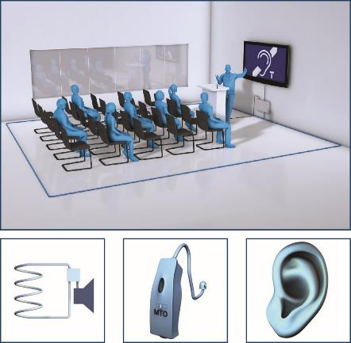
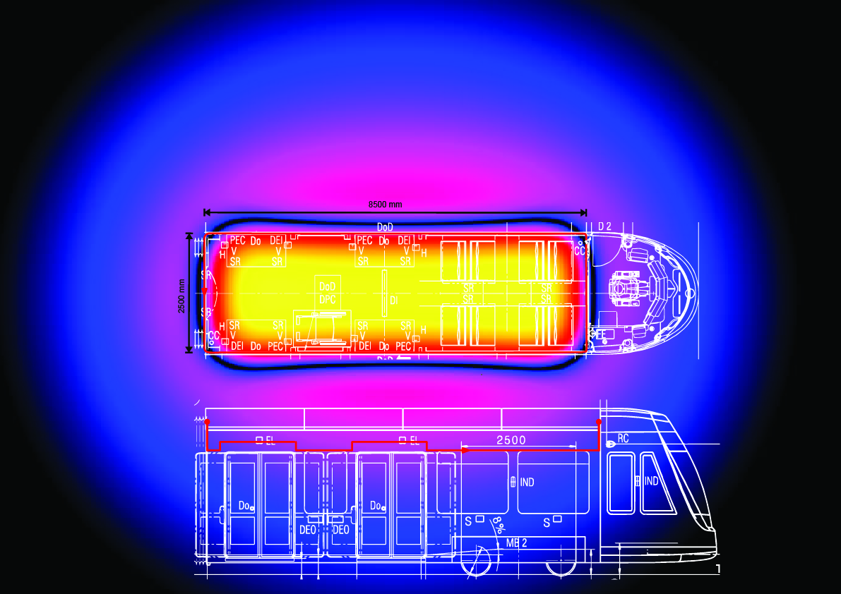
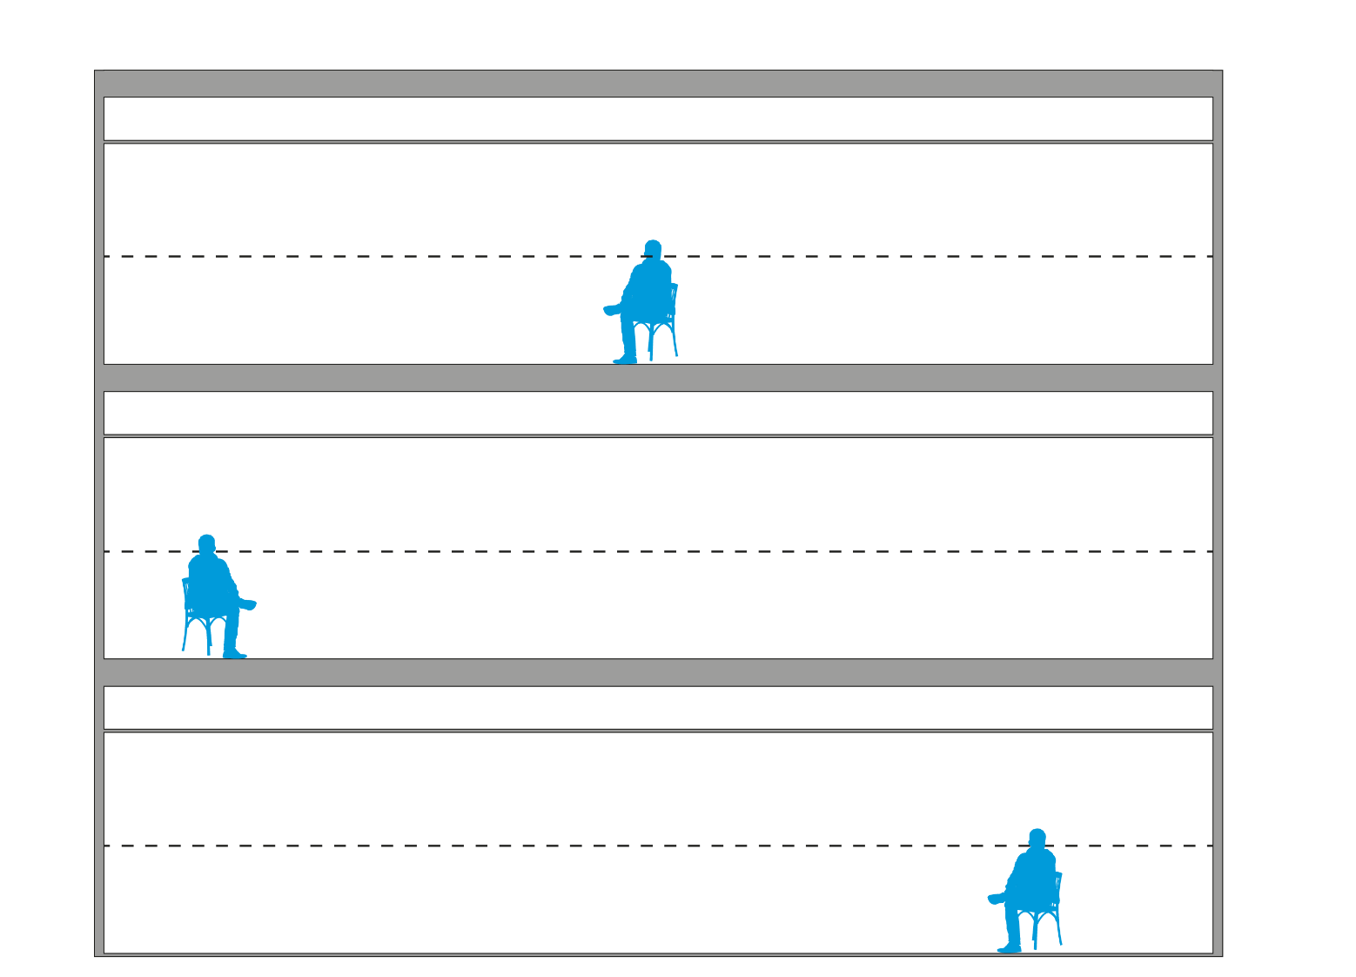

Example of a Multimedia Service: Hearing Loop 1/2
Service 21: Hearing Impaired People Support
This service allows passengers with reduced ranges of hearing to listen audible PA announcements and have intercom call with train staff. An example is the widely used audio-frequency induction loops (AFILs) or shortly hearing loops. This service could be divided in two subservices:
Subservice 21A: PA Announcement. It enables hearing impaired people to listen PA announcements.
Subservice 21B: Passenger Intercom Call. It enables an hearing impaired person to call train staff.
Notes:
On average 15-18% of the population experience hearing loss - 35% of people with hearing loss use a hearing aid.
For travellers a hearing loop is the only system that will connect a hearing aid user to a sound source discreetly and anonymously without the need for additional receivers.
A hearing loop transfers a signal from an audio source, through a magnetic field, direct to a hearing aid user via a Telecoil.
A hearing loop can be fitted into a carriage, at intercoms and information points.
To ensure magnetic field coverage and signal intelligibility a functional system needs to be commissioned to performance standard IEC 60118-4.
Adequate signage is vital to ensure travellers know a loop system is available
It is important to identify the coaches and the part of the coach fitted for this service.
It is necessary to identify the coaches and the part of the coach (seats and areas) fitted for this service.
Service 21: Hearing Impaired People Support
This service allows passengers with reduced ranges of hearing to listen audible PA announcements and have intercom call with train staff. This service is an extension of audio services 4 and 5 for people with audible disabilities. An example is the widely used Audio induction loop system, also called audio-frequency induction loops (AFILs) or hearing loops. This service could be divided in two subservices:
Subservice 21A: PA Announcement. It enables hearing impaired people to listen PA announcements. This subservice is connected to service 4 and it receives the same audible input addressed for other passengers. It is important to identify the coaches and the part of the coach fitted for this service.
Subservice 21B: Passenger Intercom Call. It enables an hearing impaired person to call train staff. This subservice is connected to service 5 and it must work properly in coordination with standard passenger intercom calls. It is necessary to identify the coaches and the part of the coach (seats and areas) fitted for this service.

Slide 6

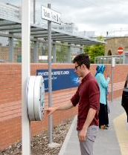
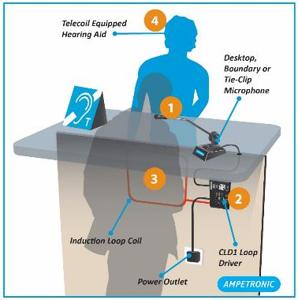
Example of a Multimedia Service: Hearing Loop 2/2
Train Station - Platform Station – Point of Sale
Audio PA and Intercom Emergency Intercom and Help Point Intercom

